Slide 1

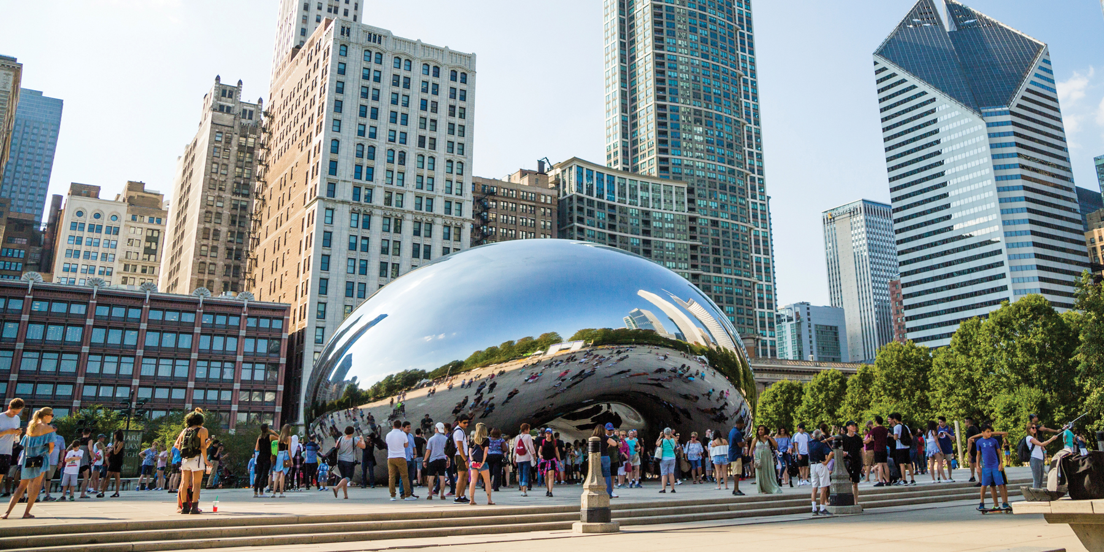
Improving Cyclistic Membership
Ishan Lamba

Slide 2
Identifying the Problem
Cyclistic wants to increase annual memberships
Customer data is private
We need to ask
How do annual members and casual riders use Cyclistic bikes differently?
Why would casual riders buy Cyclistic annual memberships?
How can Cyclistic use digital media to influence casual riders to become members?

Slide 3
Stakeholders
Any employee at Cyclistic
Investors into Cyclistic
Cyclistic customers
Chicago drivers
City of Chicago

Slide 4
Data Collection
Data was provided by Cyclistic, only last 12 months were analyzed
Data is also made available by Motivate International Inc. under this license
In rare cases, there are timestamps that are either invalid, or the end time is before the start time
While comprehensive, the dataset may include bias against low-income minorities, due to the fee associated with Cyclistic

Slide 5
Cleaning
Data was initially cleaned in Excel
Extra fields were added (ride_length, day_of_the_week, start_month) to improve data analysis
Data was further cleaned in R due to ease of combining large data sets and filtering
R Script is included in this folder

Slide 6
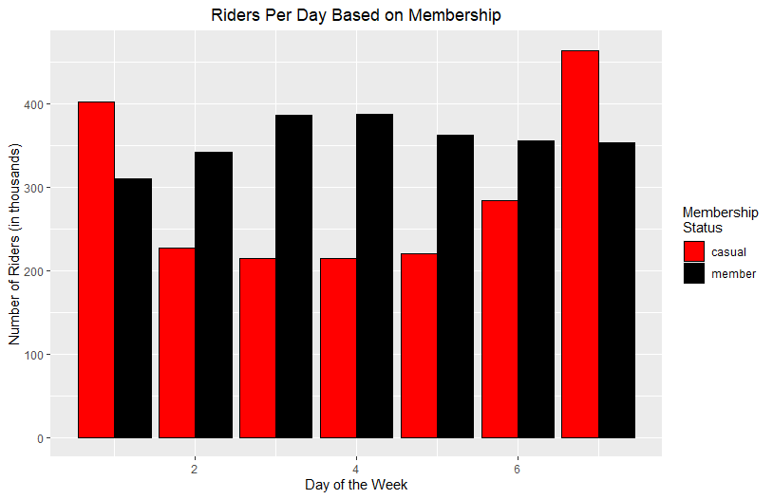
Analysis
The number of riders per day was broken down by membership
Days of the week numbered 1-7 (1 – Sunday, 7 – Saturday)
We can see that ridership among casual riders skyrockets on weekends

Slide 7
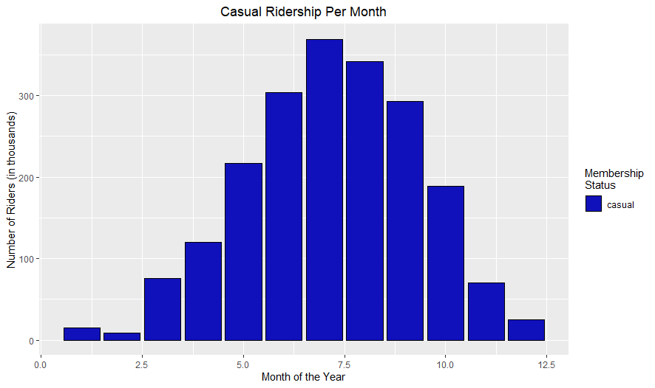
Analysis
Casual ridership analyzed by month
Months of the year numbered 1-12 (1 – January, 12 – December)
Casual ridership drops sharply in the winter months, peaking in the summer

Slide 8
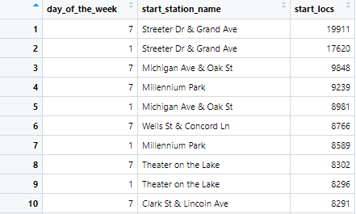
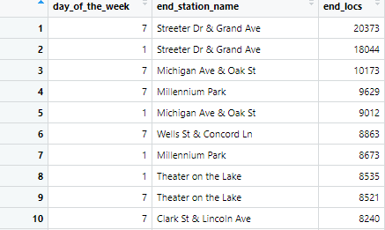
Analysis
The top 10 most common starting and ending locations for bikes were the same
All of the locations were on or near the Lake Michigan coastline
Locations are popular among tourists and younger populations in Chicago

Slide 9
What does this mean?
Casual riders tend to ride much more on weekends and in warmer weather
Likely aren’t using bikes to commute
Likely using it for leisure or convenience
Riders also tend to be younger based on popular locations
Could inform advertising strategy

Slide 10
Conclusion
It appears as though many of the casual riders, especially in the warmer months, are tourists
Although it doesn’t make sense for them to purchase an annual memberships, younger users can be targeted
Multiple different methods can be used to approach them
I recommend the following three steps to Cyclistic

Slide 11
Future Steps
Advertise on social media (where younger people are more likely to see it) and on college campuses in Chicago
Create a multi-pitch advertisement that talks about the benefit cycling has on the environment and traffic congestion or cycling’s use for exercise
Offer intermediate payment plans, such as semester memberships or summer memberships, allowing customers more financial flexibility

Slide 12
Thank you! Questions?

